Slide 1
IT LAW & ETHICS
Eleftheria TZAMAROU
Fall semester 2016

Slide 2

Session 1: Online contracting

Slide 3
E-commerce
The part of such activity that consists in the sale or purchase of goods and services
WTO definition → ‘the production, distribution, marketing, sale or delivery of goods and services by electronic means’.
may take various forms :
a relation between the entrepreneur and consumer (business-to-consumer, also known as B2C)
mutual relations between entepreneurs (business-to-business or B2B)
transactions between the business and governmental sectors (B2G)
natural persons not conducting economic activity may effect transactions online (consumer-to-consumer or C2C)

Slide 4
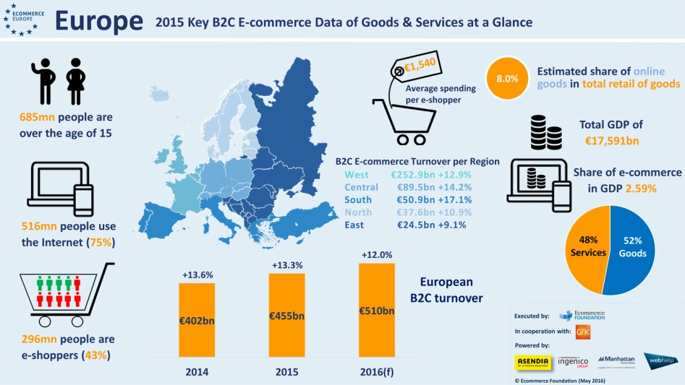
E-commerce in Europe

Slide 5

International legislation on e-commerce

Slide 6
EU Legislation
Electronic Commerce Directive (2000/31/EC Directive)
The Directive 2011/83/EC on consumer rights replaces, as of 13 June 2014, Directive 97/7/EC on the protection of consumers in respect of distance contracts and Directive 85/577/EEC to protect consumer in respect of contracts negotiated away from business premises.
REGULATION (EU) No 910/2014 on electronic identification and trust services for electronic transactions in the internal market and repealing Directive 1999/93/EC on a Community framework for electronic signatures
The Directive 93/13/EEC on Unfair Terms in Consumer Contracts protects consumers' rights where they enter into agreements with retailers who try to impose unfair terms in the agreement.

Slide 7
The EU Directive on electronic commerce
Electronic Commerce Directive (2000/31/EC Directive) adopted on 8 June 2000
sets up an Internal Market framework for electronic commerce, which provides legal certainty for business and consumers➔ removes obstacles to cross-border online services in the EU internal market (free movement of services)
deals mostly with electronic contracts in business-to-consumer (“B2C”) transactions ,
aims to remove the restrictions on the enforceability of electronic contracts due to their electronic nature (Article 9),
ensures that the recipient of services is provided with explanatory information when entering into an electronic contract (Article 10),
imposes obligations on the service provider in relation to the placing of orders by the recipient of the services (Article 11).

Slide 8
Contracts not covered
Contracts that create or transfer real estate property rights, except rental rights;
Contracts requiring, in order to be valid, registration with public authority;
Contracts of suretyship; and
Contracts falling within the scope of the law of succession and family law.

Slide 9
UK legislation
Electronic Commerce Regulations 2002 came into force in 2002 and transpose the Electronic Commerce Directive 2000/31/EC
Consumer Contracts Regulations 2013 came into force in June 2014 replacing the Consumer Protection (Distance Selling) Regulations 2000
Electronic Communications Act 2000 on admissibility of electronic signatures
The Unfair Terms in Consumer Contracts Regulations 1999

Slide 10
US legislation on e-commerce
Uniform Computer Information Transactions Act (UCITA)➔ a uniform commercial code for software licenses and other computer information transactions.
In 1999, the Uniform Electronic Transactions Act (UETA) represents the first national effort to provide uniform rules to govern electronic commerce transactions.
Electronic Signatures in Global and National Commerce Act (E-Sign) adopted in 2000
These uniform acts are not binding law in a particular state until the state chooses to adopt the act through its respective legislative process
The Federal Trade Commission (FTC) is the primary federal agency regulating e-commerce activities, including use of commercial e-mails, online advertising and consumer privacy. FTC's E-Commerce Guide provides an overview of e-commerce rules and regulations.

Slide 11
General rules on contract formation
Offer
Acceptance
Consideration (known only to common law countries, such as England)
Legal intention to create legal relations
Legal capacity to contract
General rules of contract formation are also applicable to electronic contracts.

Slide 12

Offer and Acceptance: main issues

Slide 13
Valid Offer & Acceptance
They can determine the precise time that a contract is made →from which moment the parties are legally obliged
Transfer of ownership in a contract of sale
The place of the contract, if the parties are located in different jurisdictions, and accordingly, what laws will apply, and which courts will have jurisdiction.

Slide 14
Law applicable to the contract - General rule
Recognition of the autonomy of the parties to choose the preferred applicable law.
If the trader carries out his activities in the country of the consumer's habitual residence or if he directs such activities to that country or to several countries including that country, the law applicable to the contract is that of the country in which the consumer is habitually resident.
If the parties have chosen a different law, that choice cannot deprive the consumer of the protection afforded by the mandatory provisions of the consumer's country of residence.

Slide 15
Nature of offer
A statement made with intention to be bound when it is accepted by the person to whom it is addressed.
Specific, comprehensive and capable of immediate acceptance
An electronic offer is usually published or transmitted electronically through website shops, Usenet newsgroups, or electronic mailing list, or sent by email to a specific recipient
Distinct from invitation to treat or request for information
The offer is effective when, and not until, it is communicated to the offeree.

Slide 16
Online Acceptance
Final and unqualified expression of assent to the terms of an offer. It turns a specific and comprehensive offer into an agreement. The acceptance must be unconditional and unequivocal.
Acceptance has no effect until it is communicated to the offeror, otherwise the offeror would be bound without knowing that his offer had been accepted.
Online acceptance can be made by the same mode of communication used to make the offer in the first place, or by using other modes

Slide 17
Revocation-Withdrawal
Revocation of an offer may be made at any time before it is accepted and becomes effective when it is “received” by the offeree
An acceptance can be revoked provided that the revocation reaches the offeror before the acceptance.

Slide 18
Theory and rules of message communication
Declaration Rules
Receipt Rules
Postal / Dispatch Rules
Information / Knowledge Rules

Slide 19
This article can be applied to all websites, regardless of their status as an offer or an invitation to treat.
Contract formation under 11(1) of e-commerce Directive
Use of a two-step-procedure for conclusion of online contract
1. The service provider has to acknowledge the receipt of the recipient’s order without undue delay and by electronic means.
2. The order and the acknowledgement of receipt are deemed to be received when the parties to whom they are addressed are able to access them.

Slide 20
Acknowledgement of Receipt of Order
An electronic contract is concluded when the acknowledgement of receipt of the recipient’s order is communicated by the service provider.
Acknowledgement of receipt or confirmation only contain a repetition of the terms to which the parties are already bound or order details. It may also take the form of the provision of the service paid for where that service is an information society service, such as a song download.
Usage of automatic mailing enables the service provider to automatically send an acknowledgement of receipt of the customer’s order.
Some websites even provide automatic display of acknowledgement of receipt of the order in the website directly after the customer clicks on “OK” or “submit”.

Slide 21
Application of Receipt Rule Theory
The communicated document is deemed to be received when the intended party is “able to access” it. The wording“able” in this phrase makes it clear that the party must possess the ability to access but no need to actually “access” the communicated document.
Time of receipt→ time when a message is accessible
The mere fact of the document being deposited in the recipient’s email inbox signifies receipt.

Slide 22
Information society service
Intermediary service provider
Any service normally provided for remuneration, at a distance, by means of electronic equipment for the processing (including digital compression) and storage of data, and at the individual request of a recipient of a service
Example: sale of goods on-line, offering online information or commercial communications-adverts, video-on-demand
Any natural or legal person providing an information society service

Slide 23
Liability of Intermediary service providers
The E-commerce Directive has introduced specific liability exemptions for three distinct types of intermediary services. Where the ISP:
acts as a mere conduit
cashes the material or
hosts the material.

Slide 24
Mere conduit
ISP transmits in a communication network information provided by a recipient of the service or provide access to a communication network(Internet)➔ no liability if the ISP:
does not initiate the transmission
does not select the receiver of the transmission and
does not select or modify the information contained in the transmission
The ISP is playing a passive role in such activities by acting as a mere "carrier" of data provided by third parties through its network.

Slide 25
Cashing
The purpose of a caching service is to avoid saturating the Internet with the repetitive high demand of certain material. Caching is used to cut down the amount of time it takes to request information. It works by keeping a temporary copy of information that has been requested locally for a defined amount of time.
This allows delivery to information seekers in the quickest way, because the data has less distance to travel to reach end-users. This automatic, intermediate, and temporary storage of data in local servers is called "caching“

Slide 26
Hosting
Provision of an information society service that consists of the storage of information provided by a recipient of the service.
The host shall not be liable for the information stored at the request of the recipient of the service on condition that:
He does not have actual knowledge of illegal activity or information and is not aware of facts or circumstances from which the illegal activity or information is apparent.
The host upon obtaining knowledge of or awareness of illegal activities, acts expeditiously to remove or to disable access to the information.

Slide 27
Prior information requirements
Retailers have to comply with extensive information requirements “prior to an order being placed by the recipient of the service”.
Information should be provided in a way clear, comprehensible and appropriate to the means of distance communication.
Failure to provide the required information, or to provide it in an appropriate way, could result in cancellation rights being extended by up to a year.
US Uniform Electronic Transactions Act (UETA) does not specify any information that online merchants are required to give to their clients prior to the formation of contracts.

Slide 28
Obligations of the Service Provider
The Service Provider must provide information on:
the different technical steps that a consumer must follow to conclude a contract,
whether the contract will be filed by the service provider and whether it will be accessible
the technical means for identifying and correcting input errors prior to the placing of the order, and
the languages offered for the conclusion of the contract.

Slide 29
Example: A second page or confirmation window presenting an overview of what has been ordered, and allowing the identification and correction of input errors before sending the order to the service provider. It requires the customer to confirm that input by clicking once again on “OK” or a similar button
Correction of Input Errors-Double Click Requirement
Placing an order by clicking “OK” or “Submit” on the provided form,
BUT
Article 11(2) of the E-commerce Directive stipulates that the service provider should make available to the recipient of the service appropriate, effective, and accessible technical means allowing him to identify and correct input errors, prior to the placing of the order.

Slide 30
No additional payments as default option
Pre-ticked boxes when placing an order
For online purchases, consumer should explicitly acknowledge, for example by pressing a button, that he is aware that placing an order implies an obligation to pay.
Traders will need the active consent of the consumer for all payments. Pre-ticked boxes for additional payments, for instance, are no longer permitted.
Consumers will not be liable for costs which they have not been told, pre-contract, that they must bear.

Slide 31
Distance contracts
Any contract concluded between the trader and the consumer under an organised distance sales or service-provision scheme without the simultaneous physical presence of the trader and the consumer, with the exclusive use of one or more means of distance communication up to and including the time at which the contract is concluded.

Slide 32
Information prior to an order being placed (1)
Full trading name and contact details
Address and identity of any other trader for whom the trader is acting
Main characteristics of the goods, services or digital content
The price, including all taxes or the manner in which the price will be calculated if this can’t be determined
The arrangements for payment, delivery of goods or performance of services and any additional delivery costs
Any additional cost for using a specific means of distance communication to make the contract where that cost is calculated other than at the basic rate (i.e. if you make an extra charge for buying by phone)
The minimum duration of the contract (i.e. a minimum period for a mobile phone contract) and the conditions for terminating it

Slide 33
Information prior to an order being placed (2)
the conditions, time limits and procedure for exercising a right to cancel, if there is one (Cooling off period of 14 days). The trader needs to provide, or make available, a standard cancellation form to make cancelling easy
details of who pays for the cost of returning items if you have a right to cancel and change your mind
the complaint handling policy
functionality and interoperability of digital content
the monthly, or billing period, costs of open-ended contracts or subscriptions( i.e. internet or pay-TV subscriptions)
any guarantees or after-sales services you offer
dispute resolution mechanisms

Slide 34
Additional requirements for distance contracts
Retailer must also ensure that consumers expressly acknowledge that they are under an obligation to pay when they place their order.
If a button or similar function is used to enable the consumer to place their order this must be labelled in an easily legible manner with the words 'order with obligation to pay'; you may use different phrases, such as 'buy now', 'pay now' or 'confirm purchase', as long as they have a similar effect.
If retailer does not meet this requirement the consumer will not be bound by the contract.

Slide 35
Information on a durable medium
A durable medium is defined as paper, email or other medium that:
allows the information to be addressed personally to the recipient
enables the recipient to store the information and access it for future reference (this includes placing the information in the customer's personal account area of retailer’s website, which he can access by logging in)
allows unchanged reproduction of this information

Slide 36
Terms bind the parties
The information provided on the trader’s website should be binding on the parties and, if the trader wishes to alter any of its elements, he should obtain the consumer’s express consent
Failure to do so will mean that the consumer is not bound by the change of information.
-For example, the parties could expressly agree, by exchanging e-mails, on a different time of delivery of the goods than the one specified on the trader’s website;
-However, a provision in the general terms and conditions stating that the trader may derogate from the information provided on the website would not comply with the requirement for express agreement of the parties.

